Slide 1
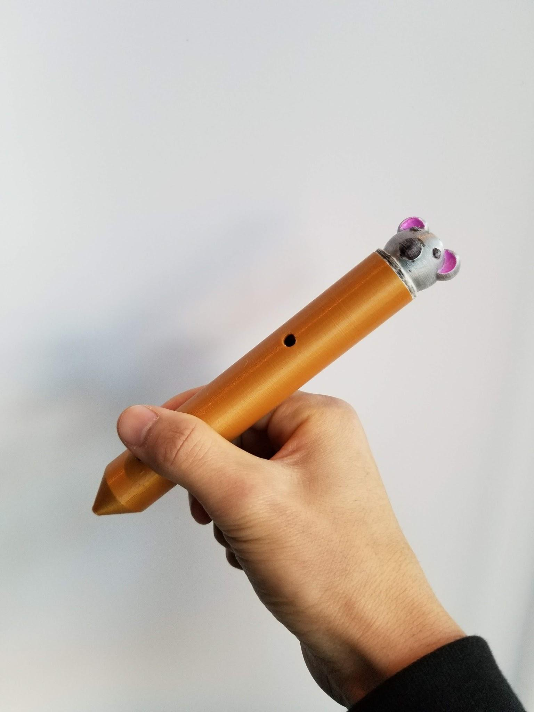
Penley
An IDEAHACKS project by Aidan Cookson, Calvin Chang, Daniel Truong, Krish Kabra, Max Gong

Slide 2
Penley makes note-taking easier

Slide 3
Penley will transcribe your notes

Slide 4
Why Penley?

Slide 5
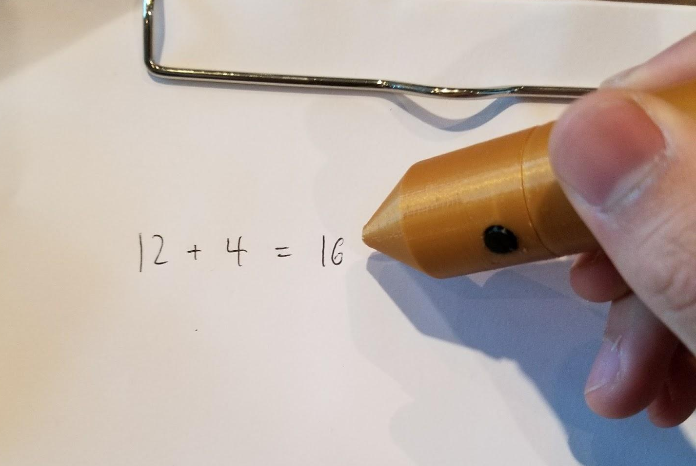
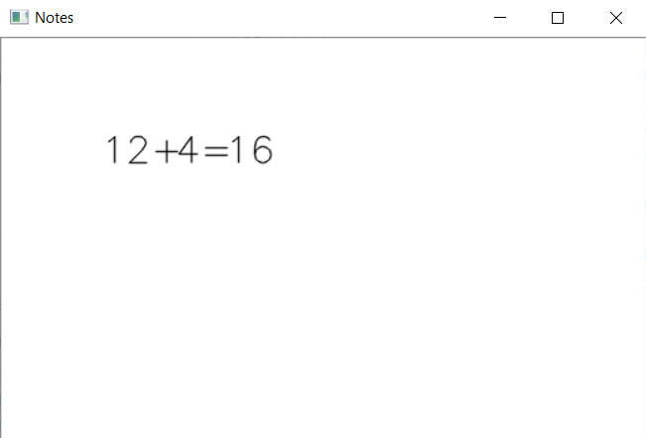
With Penley, you have access to both written & transcribed notes
Notes:
With Pensley, you have access to both written & transcribed notes. So whenever you written notes are messy, you can always refer to your transcribed notes. This means you can study much better.

Slide 6
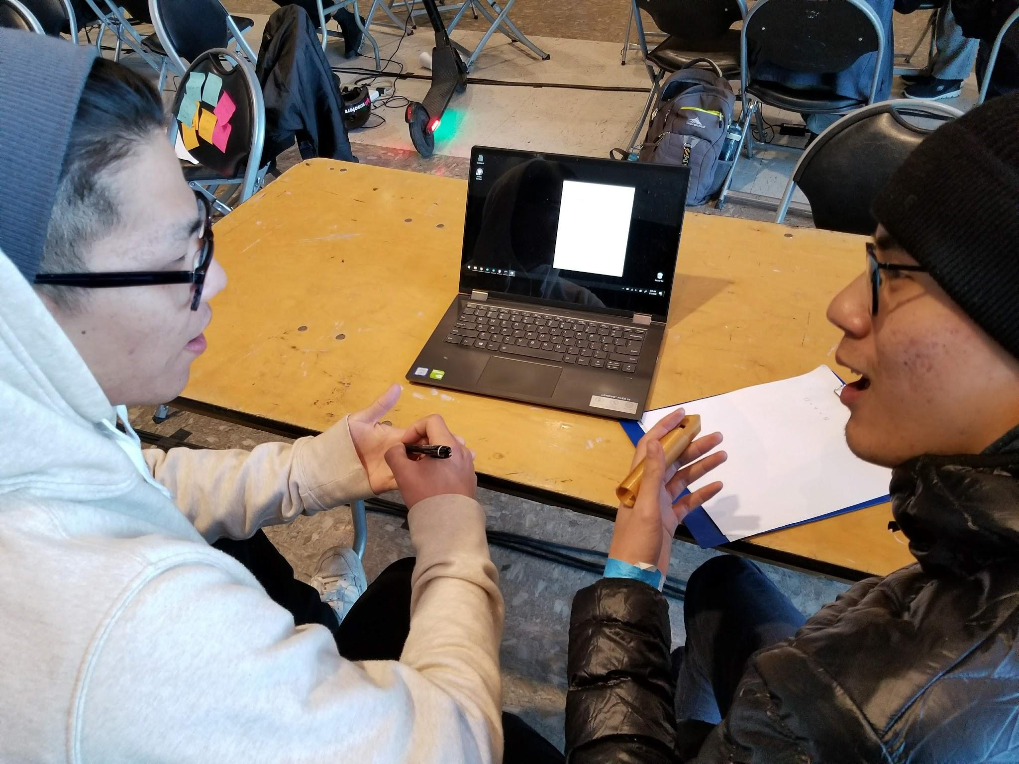
With Penley, others can easily read your transcribed notes
Notes:
With Penley, others can easily read your transcribed notes. This makes it perfect for teachers and TAs to use if they want to share notes with their students.

Slide 7
Unlike competitors …
Penley can write on any surface
Notes:
Unlike competitors like LiveScribe, you can use Penley on any surface -- paper, whiteboard,
You also don’t need ink to write, which means you can save paper and be environmentally friendly.

Slide 8

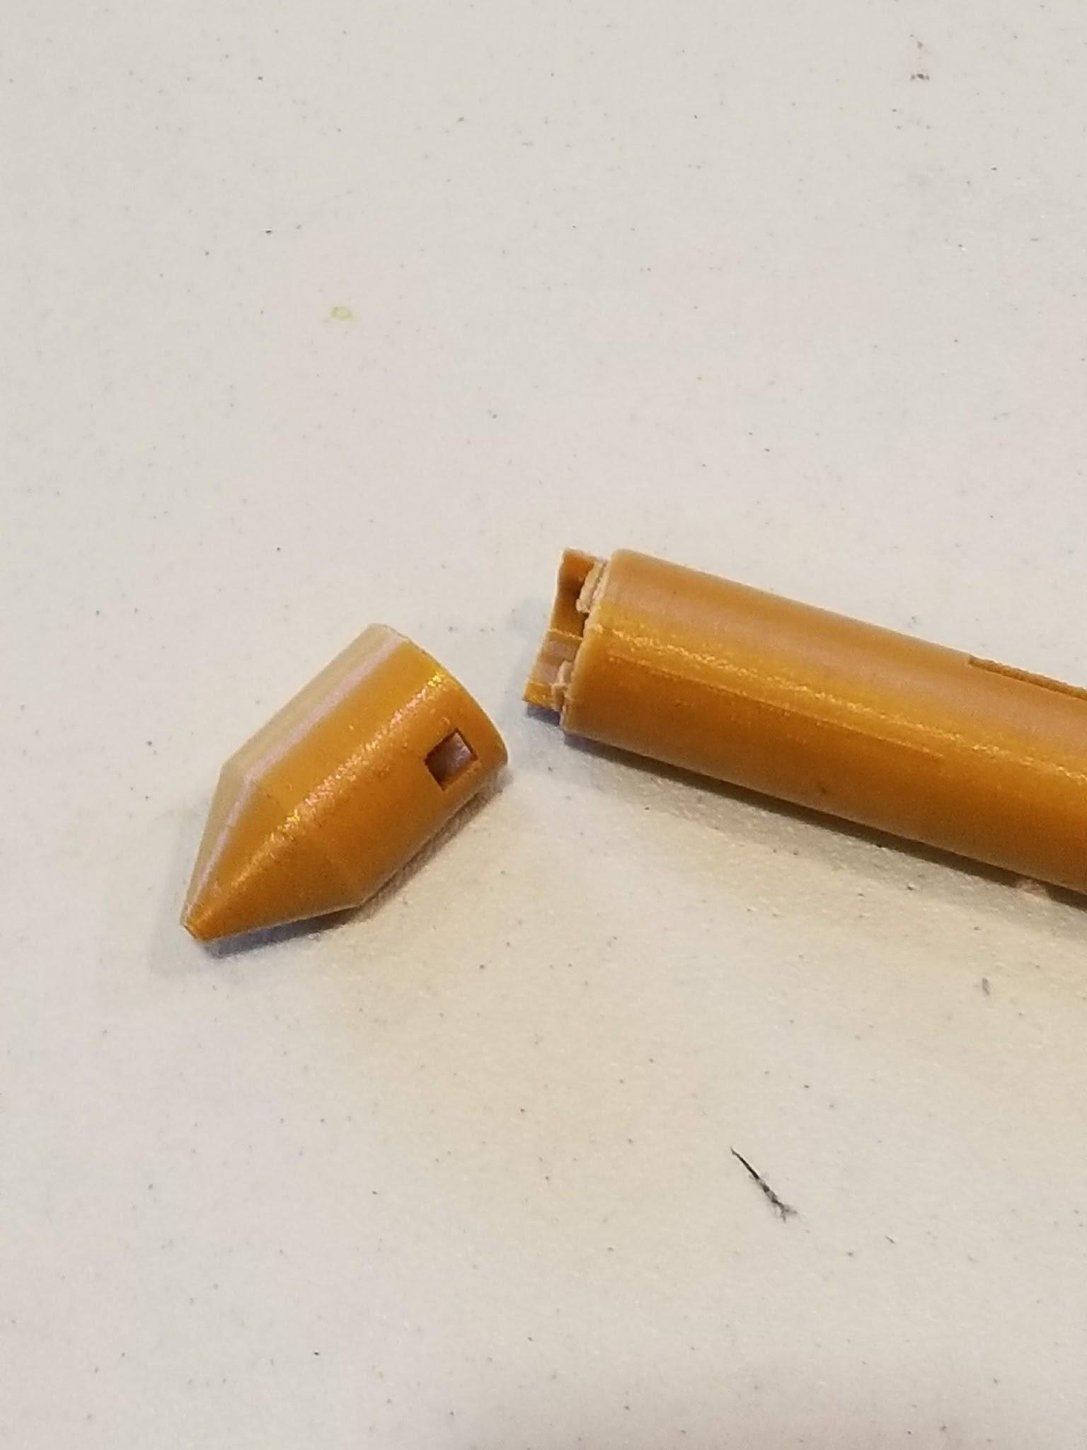

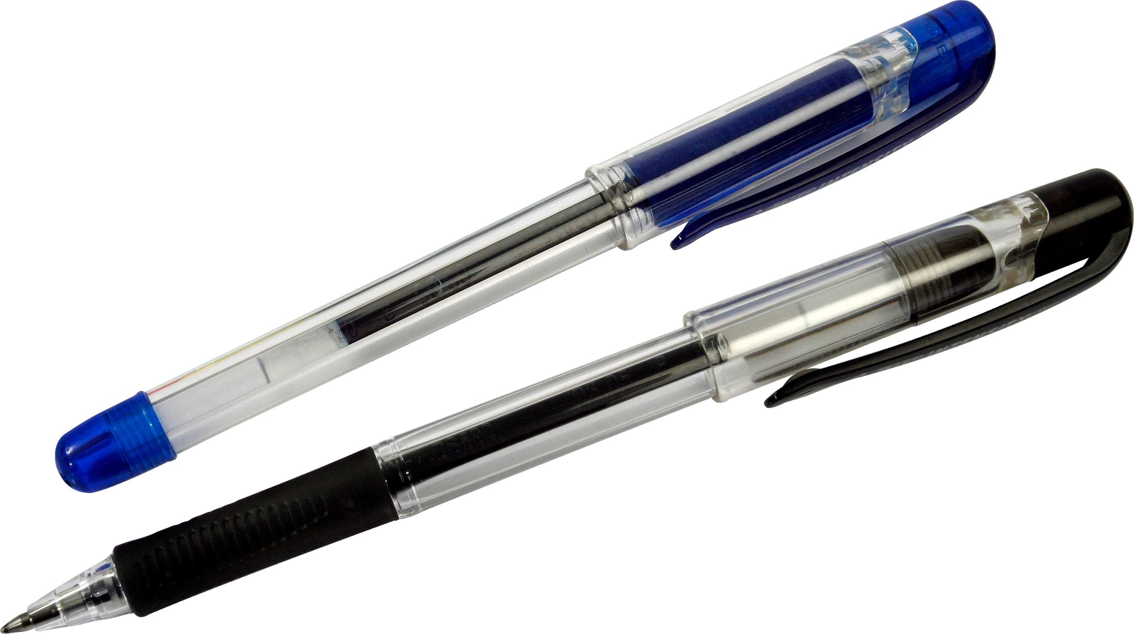
Penley is modular
Notes:
With its removable tip, Penley can transform into a pencil, pen, and even a whiteboard marker

Slide 9
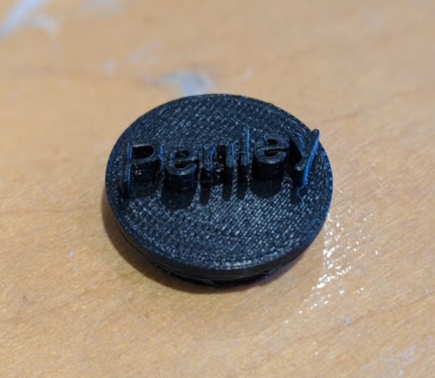
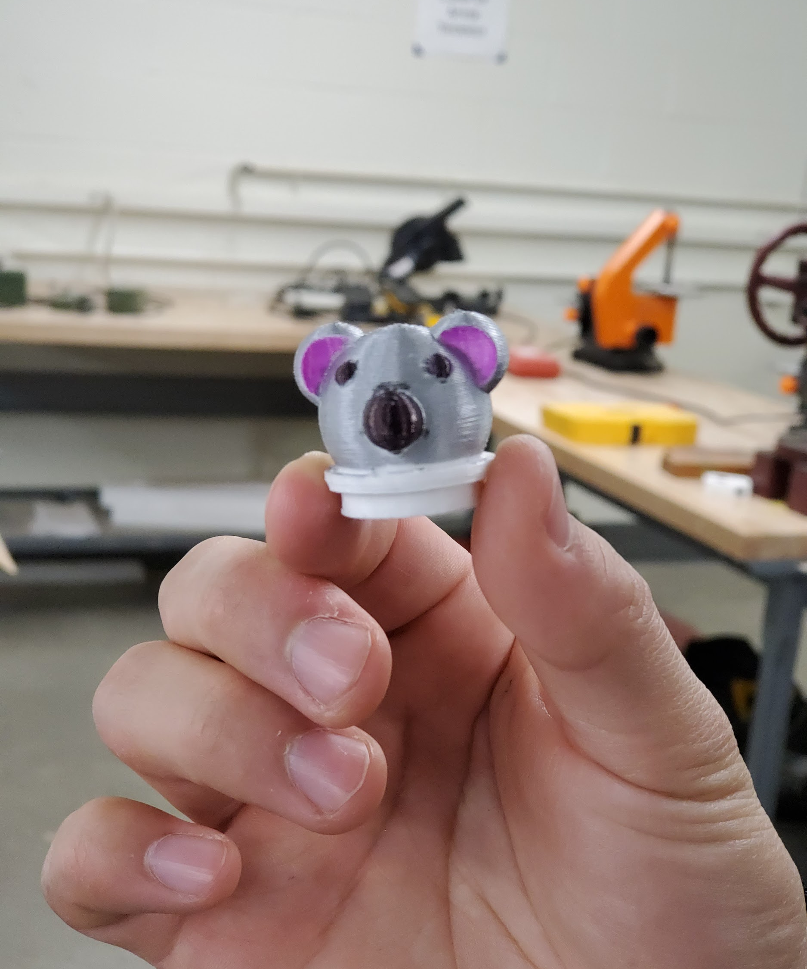
You can customize your Penley cap!

Slide 10
How Penley?

Slide 11
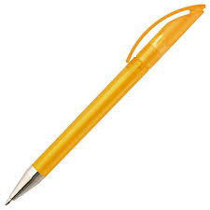

Motion tracking
Convolutional Neural Network
5
5
Write character
Identify the character written

Slide 12
Future Penley

Slide 13


Improvements
Thinner Body
Ergonomics
Alphabet Capability
Aa
Notes:
With Modern and optimized components the body of the Penly can be slimmed down
Allowing for improved Ergonomics
In its most advanced state Penly, will have the capability to transcribe any alphabet and even numerical symbols.

Slide 14
Thanks!

Slide 15
Appendix

Slide 16
How does Penley work?

Slide 17
How Penley?

Slide 18


Dataflow
6DOF IMU
Pre-Processing
Arduino Nano
Serial Data
CNN
Bluetooth
Display

Slide 19
Software
Arduino
CNN
GUI
Interrupt service routine with button
Reads accelerometer and gyroscope values
Sends data to the bluetooth module until button is released
Keras and Tensorflow
Created our own dataset with 1100 samples
OpenCV
CAD?
Buttons?
LED indicator?

Slide 20
14%
Of all trees cut down each year are for paper

Slide 22
50% higher scores
Students using the Penley score 50% higher on exams than regular students.
Fake news...

